Slide 1
A modern web backend based on SQL Server
Dr. Benjamin Kettner

Slide 2
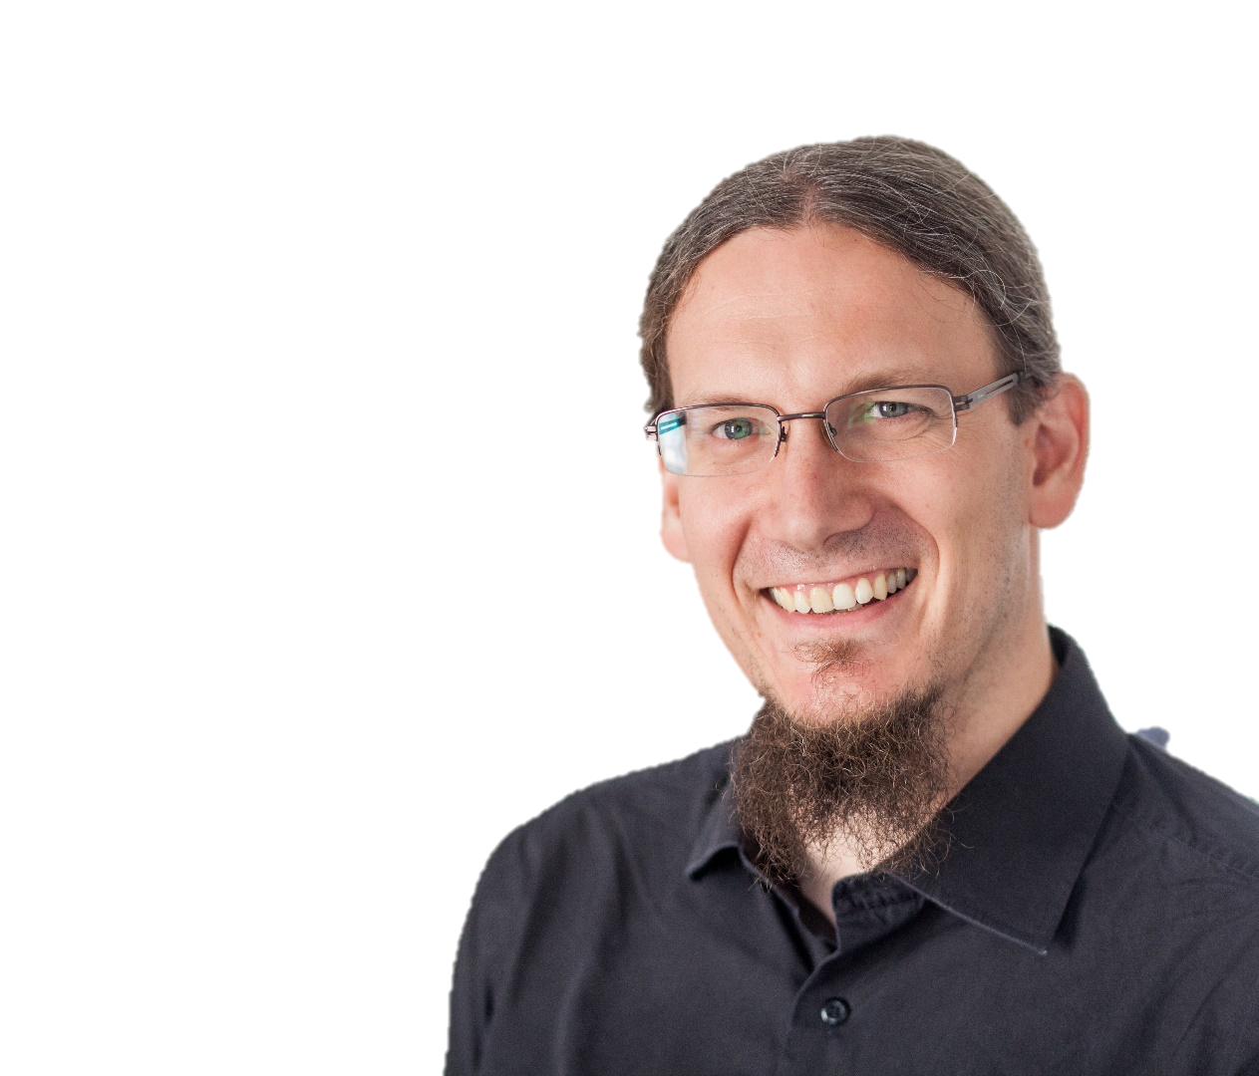

Dr. Benjamin Kettner
Benjamin.kettner@ml-pa.com
(Domnestizierter) Mathematiker
CTO ML!PA Consulting GmbH
Wahl-Berliner
Chapter Lead PASS RG Berlin
Mathematik,
I(o)T Projekte,
Community,
Musik

Slide 3
Web development cycle (in your dreams)
I would like a feature
Request
Sprint plan
Develop & Test
Frontend & Backend
(with priority)
User
Product Owner
DEV
Team
Cool, thank you!
Tested implementation
Tested implementation

Slide 4
Web development cycle (ugly reality)
Request
(urgent!)
I would like a feature
Change A to API
WTF?
Backend
is the bottleneck
WTF?
Backend
is the bottleneck
User
Maybe the user would like…?
Product Owner
Frontend DEVs
Backend DEV
Backend
is the bottleneck
Request
(urgent!)
Change B to API

Slide 5
Result (apart from no features being delivered)
Maybe we can do without a backend?
Do we really need a backend?
Guys?
Backend is always a problem!
User
Product Owner
Frontend DEVs
Backend DEV

Slide 6
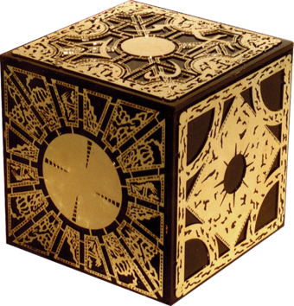
Worst case scenario
Data model built by Javascript-Guys
Security concept designed by end-user
Un-administered DB server
Let‘s not open the gates of hell (today)!
Can‘t we make the backend more flexible so that not every new field is a change in the API?
Some clever guy

Slide 7

Enter stage: GRAPH QL (yes, another „QL“)
What it is:
An open source language for
querying and
manipulating data
Flexible
Available Cross-Plattform
JSON-Based
What it is not:
An universal remedy
DDL
A way to make backend (developers) obsolete
A replacement for SQL

Slide 8
The path of data
Database
Query: JSON as POST body
WebApp
GraphQL middleware
Entity Framework modeling
Types, Queries and Mutations
Resolver/Repository

Slide 9
Process when developing GraphQL BE
Develop data model (in SQL Server)
Make object-relational model using Entity Framework
Write GraphQL types and connect them to EF-Model classes
Write Query and Mutation methods for each type
Repeat for each object in ER model (tiring and error-prone).

Slide 10
Maybe we can automate some of this?
Goal:
Not 100% automation
Deal with 80% cases that deal with DB entities directly
Adhere to naming conventions
Enforce certain best practices

Slide 11
Enough talk, show me some action!
Demo-Time!

Slide 12
What have you seen?
ORM modeling using Entity Framework
Dotnet Boxed templates for GraphQL middleware
Automatic generation of GraphQL types, queries & mutations
Generic mapping of GraphQL objects to DB objects

Slide 13
And most important!
SQL Server can be used to build Backend solutions for modern Web applications!
(It does not have to be MySQL, MariaDB or PostgreSQL, please tell your web developers!)

Slide 14

Thank you very much for your attention. Vielen Dank für Eure Aufmerksamkeit.

